Slide 1




Acupuncture Effectiveness for Low Back Pain in Older Adults: Whole Health and Cost-Benefit Outcomes and Navigating the Government Payer Landscape
ICIMH Panel Presentation -- March 5, 2025
Lynn DeBar, PhD, MPH, Principal Investigator, KP Center for Health Research
Patricia Herman, ND, PhD, Co-Director, RAND REACH Center
Ray Teets, MD, Physician, Institute for Family Health
Wendy Weber, ND, PhD, MPH, Branch Chief, NCCIH
Jeffrey A. Dusek, PhD, Professor, Univ of California, Irvine/Director of Outcomes Research, Susan Samueli Integrative Health Institute (Session Moderator)

Slide 2
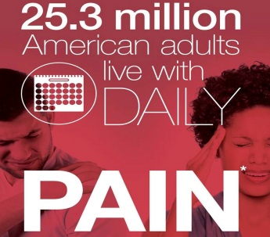
The Pain and Overdose Crisis
107,941 reported deaths in 2022
81,806 from Opioids (Prescription and Illicit)
  Nationwide prevalence
  50 million adults with chronic pain
  25 million report severe pain daily
  20 million with high impact chronic pain*
Source: The Multiple Cause of Death data are produced by the Division of Vital Statistics, NCHS, CDC, US DHHS.

Slide 3

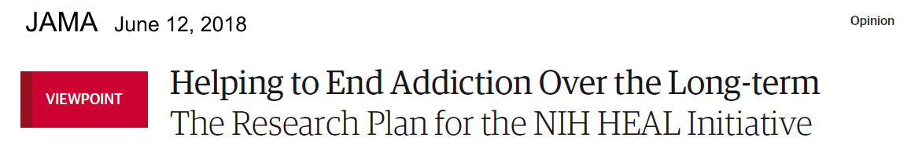
NIH Helping to End Addiction Long-term (HEAL) Initiative
Led by Drs. Volkow and Koroshetz – Scientific Directors
2018-2025, >2,200 research projects in all 50 states, totaling over $3.9 billion
Collaboration across 19 NIH Institutes and Centers
>40 FDA approvals for investigational new drugs or devices
300+ clinical trials under way
Active ongoing partnerships with communities, federal, state, and local agencies, private sector companies, and academia
Read about the research plan:
www.nih.gov/heal-initiative
Collins, Koroshetz, Volkow; JAMA, 2018

Slide 4



NIH Pragmatic Trials Collaboratory
History: Initiated in 2012 via the NIH Common Fund, now transitioned to sustained funding from multiple NIH Institutes and Centers plus NIH HEAL Initiative
Goal: Strengthen the national capacity to implement cost-effective, large-scale research studies that engage healthcare delivery organizations as partners
Vision: Support the design and conduct of innovative embedded pragmatic clinical trials (ePCTs) to establish best practices and disseminate knowledge

Slide 5





Why Do an ePCT? The 5 Rs
Relevant Question
Real-World Setting
Representative Population
Routinely Collected Data
Rigorous Methods
  The question is pressing, and healthcare system leaders, patients, and front-line clinicians care about the answer.
  Desire to test in diverse healthcare delivery settings with the hope of implementing findings widely.
  Ability to recruit a population reflective of patients with the condition, including those from minoritized communities.
  Can use data collected as part of healthcare delivery to answer the question, supplemented by data from other sources.
  Randomized research is needed to answer the question and inform changes in care, policy, or reimbursement.

Slide 6


Program Reach
Support >30 large-scale,
high-impact ePCTs
14
NIH Institutes and Centers
>1,400
clinical sites
>1.2 million
patients
49
US States
and Puerto Rico
No sites in Arkansas

Slide 7
HEAL-Funded NIH Collaboratory Trials
NIH HEAL Initiative® funding since 2019
Supports ePCTs of non-opioid interventions for:
  Treating pain
  Improving pain management
  Reducing reliance on opioids
Aim: Improve availability of, effectiveness of, and adherence to evidence-based, nonpharmacologic pain management

Slide 8
Study Design, methods, and main findings
Lynn L DeBar – Kaiser Permanente Center for Health Research
Andrea J Cook – Kaiser Permanente Washington Health Research Institute
Robert D. Wellman – Kaiser Permanente Washington Health Research Institute

Slide 9
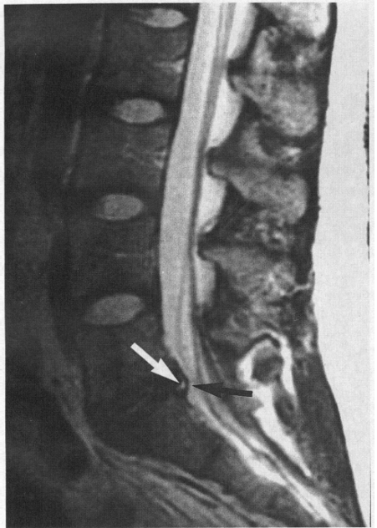
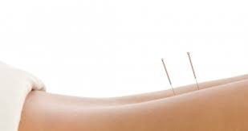
Low Back Pain In Older Adults (the What & Why)
Leading cause of disability worldwide
High cost-burden (>$100B/year in the U.S.)
Older adults at higher risk for complications
  Opioids and other pain medications
  Back imaging is unreliable
  Common co-morbid health conditions
Acupuncture safe and effective
In theory, can treat broader problems
  Sleep problems
  Fatigue
  Emotional well-being
Personalized treatment
  (but constrained in the study)
  Included evaluating impact of maintenance sessions
Medicare coverage determination (pending to coverage over course of study)
Notes:
Back pain leading cause of disability in the world with older adults most impacted (Over 1/3 report low back pain)
LOTS of healthcare dollars spent ($86 billion per year) yet problem getting worse
Older adults more at risk for problems with back pain drugs and surgery treatments
Opioids and other drugs to treat pain can interact with other medications older adults commonly take and cause (sometimes dangerous) side effects
Back imaging can show age-related changes not reliably associated with pain but that result in surgeries and other invasive care.
Other medical conditions can make be worsened by conventional medical pain treatments (medications / surgery) or make such treatments less effective

Slide 10
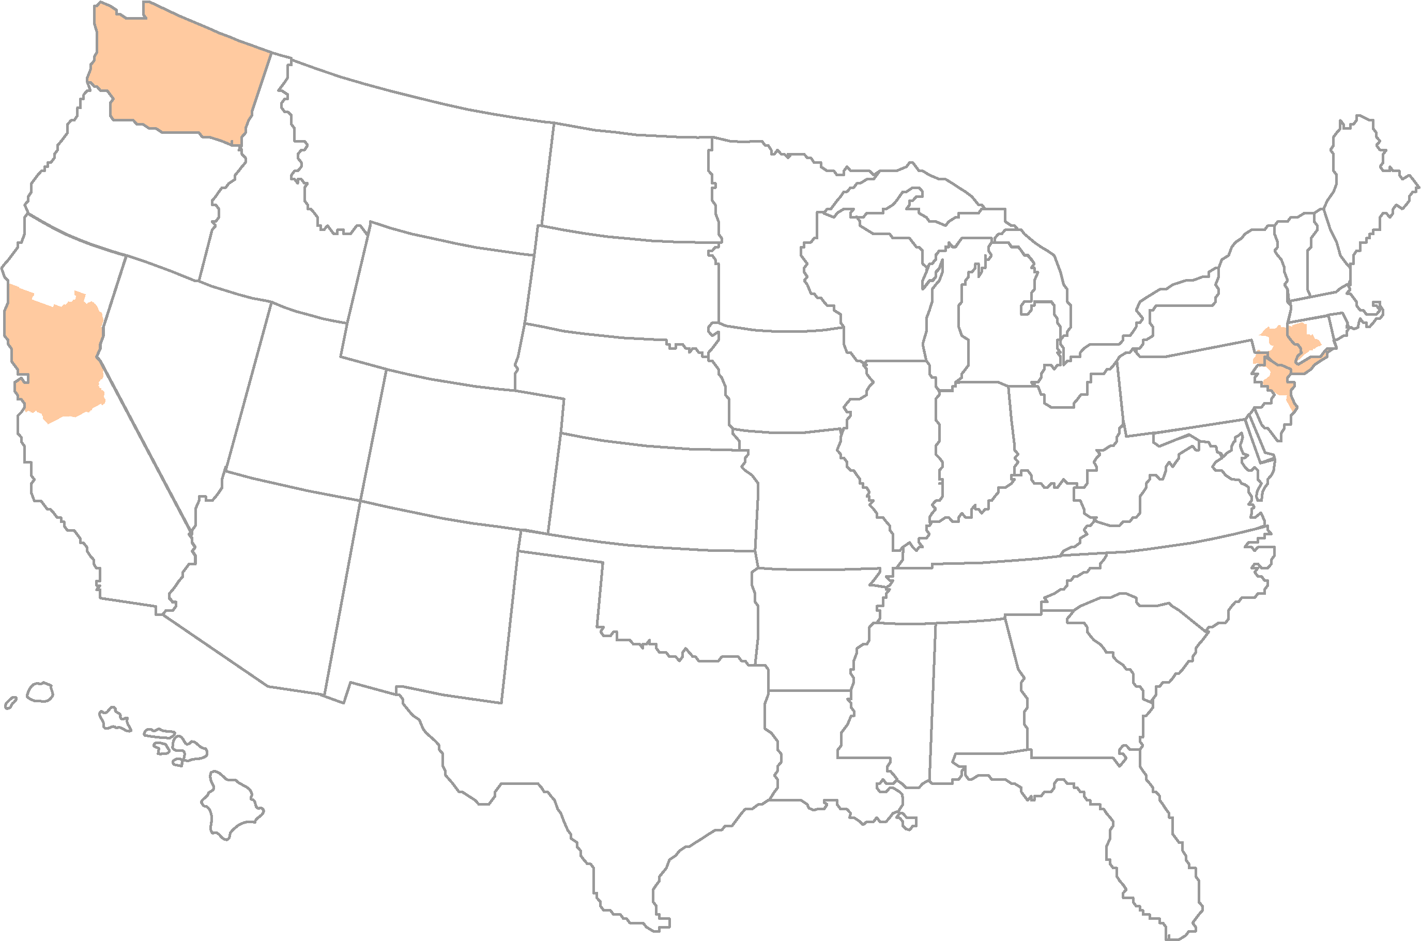
BackInAction Overview
AIM: To test the effectiveness of acupuncture needling among older adults with cLBP to:
    Improve back pain-related disability
    Evaluate acupuncture needling dose-dependence and safety for older adults
    Inform CMS Medicare Coverage Decision/Impact (outcomes + acupuncturist/key informant interviews)
    Evaluate cost-utility and cost effectiveness of acupuncture intervention
DESIGN: 3-arm (standard acupuncture/enhanced acupuncture/usual medical care only) pragmatic trial (800 participants)
ELIGIBILITY: ≥ 65 years of age with EHR diagnosis of uncomplicated chronic low back pain meeting threshold of pain-related general activity interference (≥ 3 on PEG)
SETTINGS:
Kaiser Permanente Washington
Kaiser Permanente Northern California
Sutter Health Northern California
Institute of Family Health NYC
INTERVENTIONS:
Arm 1: Standard (15 treatment sessions over 12 weeks)
Arm 2: Enhanced (6 additional maintenance sessions over following 12 weeks)
50+ community- (KPNC, KPWA, SH) or primary clinic-
based (IFH) acupuncturists delivering intervention
DeBar LL, et al. Contemporary Clinical Trials. 2023 March 27.
Nielsen A, et al. Glob Adv Health Med. 2021.

Slide 11
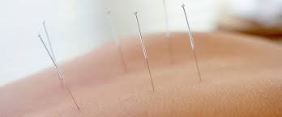
Acupuncture Treatment
Providers
  Licensed acupuncturists (LAc s) practicing independently in community (consistent with healthcare system care delivery norms)
  Acupuncturists embedded in primary care in NYC FQHC network sites
  ≥5 years clinical/practice experience treating chronic pain in older adults
  Acupuncturists allowed up to 60 minutes per session at $90/hour
Treatment
  ‘Responsive’ acupuncture intervention – Delphi evidence-based consensus process> acupoint options to individualize tx to patient needs
Nielsen A, et al. Glob Adv Health Med. 2021

Slide 12
‘Responsive’ acupuncture needling:
STRICTA details
40-60 min session duration
  CMS schedules to pay for two 15-minute needling blocks
6-20 insertion points recommended (including local and distal points)
  Off grid points allowed w/rationale
10-25 minutes needle retention time recommended:
No other Traditional East Asian Medicine modalities allowed
  (Heat, Tuina, electroacupuncture, Ba Guan cupping, Gua Sha, moxibustion, or herbal medicine)
Nielsen A, et al. Glob Adv Health Med. 2021.

Slide 13
(Session form) with Acupoint Grid
Back of the Body
Left |  |  |  | C | Right
BL |  | BL | HTJJ | GV | HTJJ | BL | BL
 |  | BL10 |  |  |  | BL10
 |  | BL11 | T1 | GV14 | T1 | BL11
BL41 |  | BL 12 | T2 |  | T2 | BL12 | BL41
BL42 |  | BL13 | T3 |  | T3 | BL 13 | BL42
BL43 |  | BL14 |  |  |  | BL14 | BL43
BL44 |  | BL15 | T5 | GV11 | T5 | BL15 | BL44
BL45 |  |  | T6 |  | T6 |  | BL45
BL 46 |  | BL17 | T7 |  | T7 | BL17 | BL 46
BL 47 |  | BL18 | T9 |  | T9 | BL18 | BL 47
BL48 |  | BL19 | T10 |  | T10 | BL19 | BL48
Bl 49 |  | BL20 | T11 |  | T11 | BL20 | BL 49
BL50 |  | BL21 | T12 |  | T12 | BL21 | BL 50
Pi Gen | BL51 | BL 22 | L1 |  | L1 | BL 22 | BL51 | Pi Gen
BL52 |  | BL23 | L2 | GV4 | L2 | BL 23 | BL52
 |  | BL24 | L3 |  | L3 | BL24
Yao Yan |  | BL25 | L4 | GV3 | L4 | BL25 | Yao Yan
Huan Zhong |  |  |  |  |  |  | Huan Zhong
 |  | BL26 | L5 | SQZX | L5 | BL26
SI Joint |  | BL27 |  |  |  | BL27 | SI Joint
BL53 |  | BL28 |  |  |  | BL28 | BL53
 |  | BL29 |  |  |  | BL29
 |  | BL30 |  |  |  | BL30
GB29 |  |  |  |  |  |  | Gb29
GB30 |  |  |  |  |  |  | Gb30
 |  | BL31 |  |  |  | BL31
 |  | BL32 |  |  |  | BL32
BL54 |  | BL33 |  | GV2 |  | BL33 | BL54
 |  | BL34 |  |  |  | BL34
 |  | BL35 |  |  |  | BL35
Front of the Legs and Feet
Left |  |  |  |  |  |  |  |  |  | Right
GB31 |  |  |  |  |  |  |  |  |  |  |  |  |  |  | GB31
GB34 |  |  | ST36 |  |  |  |  |  |  |  |  |  | ST36 |  | GB34
 |  |  | ST37 |  |  |  |  |  |  |  |  |  | ST37
GB37 |  |  |  |  |  |  |  |  |  |  |  |  |  |  | GB37
GB39 |  |  |  |  |  |  |  |  |  |  |  |  |  |  | GB39
 |  |  |  | SP6 |  |  | KI7 |  |  | KI7 | SP6
GB40 |  |  |  | Sp5 |  |  |  | KI4 |  | KI4 | Sp5 |  |  | GB40
TW5 |  | GB41 |  |  |  |  |  | KI3 |  | KI3 |  |  |  | GB41 |  | TW5
 | Liv 3 |  |  | SP2 |  |  |  |  |  |  |  | SP2 |  | Liv 3
Back of the Legs
BL36 |  | BL36
BL37 |  | BL37
BL 38 |  | BL38
BL 39 |  | BL 39
BL 40 |  | BL 40
BL 57 |  | BL 57
BL58 |  | BL58
BL 59 |  | BL 59
BL 60 |  | BL 60
BL 62 | SI3 | SI3 | BL62
Point grid displayed according to point geography for facile recording

Slide 14
Acupuncture Treatment Dosing Details
Standard acupuncture: 8-15 treatment sessions over 12 weeks
Sessions completed: Median (Interquartile Range [IQR]) = 11 (8, 14)
96% at least one visit
82% at least eight visits (considered ‘therapeutic dose’)
22% attended all 15 visits allowed
Average session length: Median (IQR) = 55 minutes (45, 60)
Enhanced acupuncture: Standard plus up to 6 extra over next 12 weeks
Sessions completed: Median (IQR) = 6 (4, 6)
86% at least one visit
58% attended all 6 visits allowed
Average session length: Median (IQR) = 54 minutes (45, 60)

Slide 15
BackInAction Outcome Measures
Patient-Reported Outcomes (PROs)
Roland Morris Disability Questionnaire (RMDQ) | Primary | Study assessment
RMDQ – minimal clinically important difference (MCID) | Secondary | Study assessment
PEG (continuous and MCID), Pain Intensity (Post-hoc) | Secondary | Study assessment
Physical Functioning (PROMIS) | Secondary | Study assessment
Patient Global Impression of Change (PGIC) | Secondary | Study assessment
Sleep Quality and Duration (PROMIS) | Exploratory | Study assessment
Depression and Anxiety (PHQ4) | Exploratory | Study assessment
Fatigue (PROMIS) | Exploratory | Study assessment
Social Role Functioning (PROMIS) | Exploratory | Study assessment
Outcomes Related to Cost Analyses – Quality Adjusted Life Years using:
EQ-5D-5L | Descriptive (Power N/A) | Study assessment
Health Services Received (ambulatory visits, telephone and email encounters, inpatient care, medications dispensed, procedures ) | Descriptive (Power N/A) | EHR

Slide 16
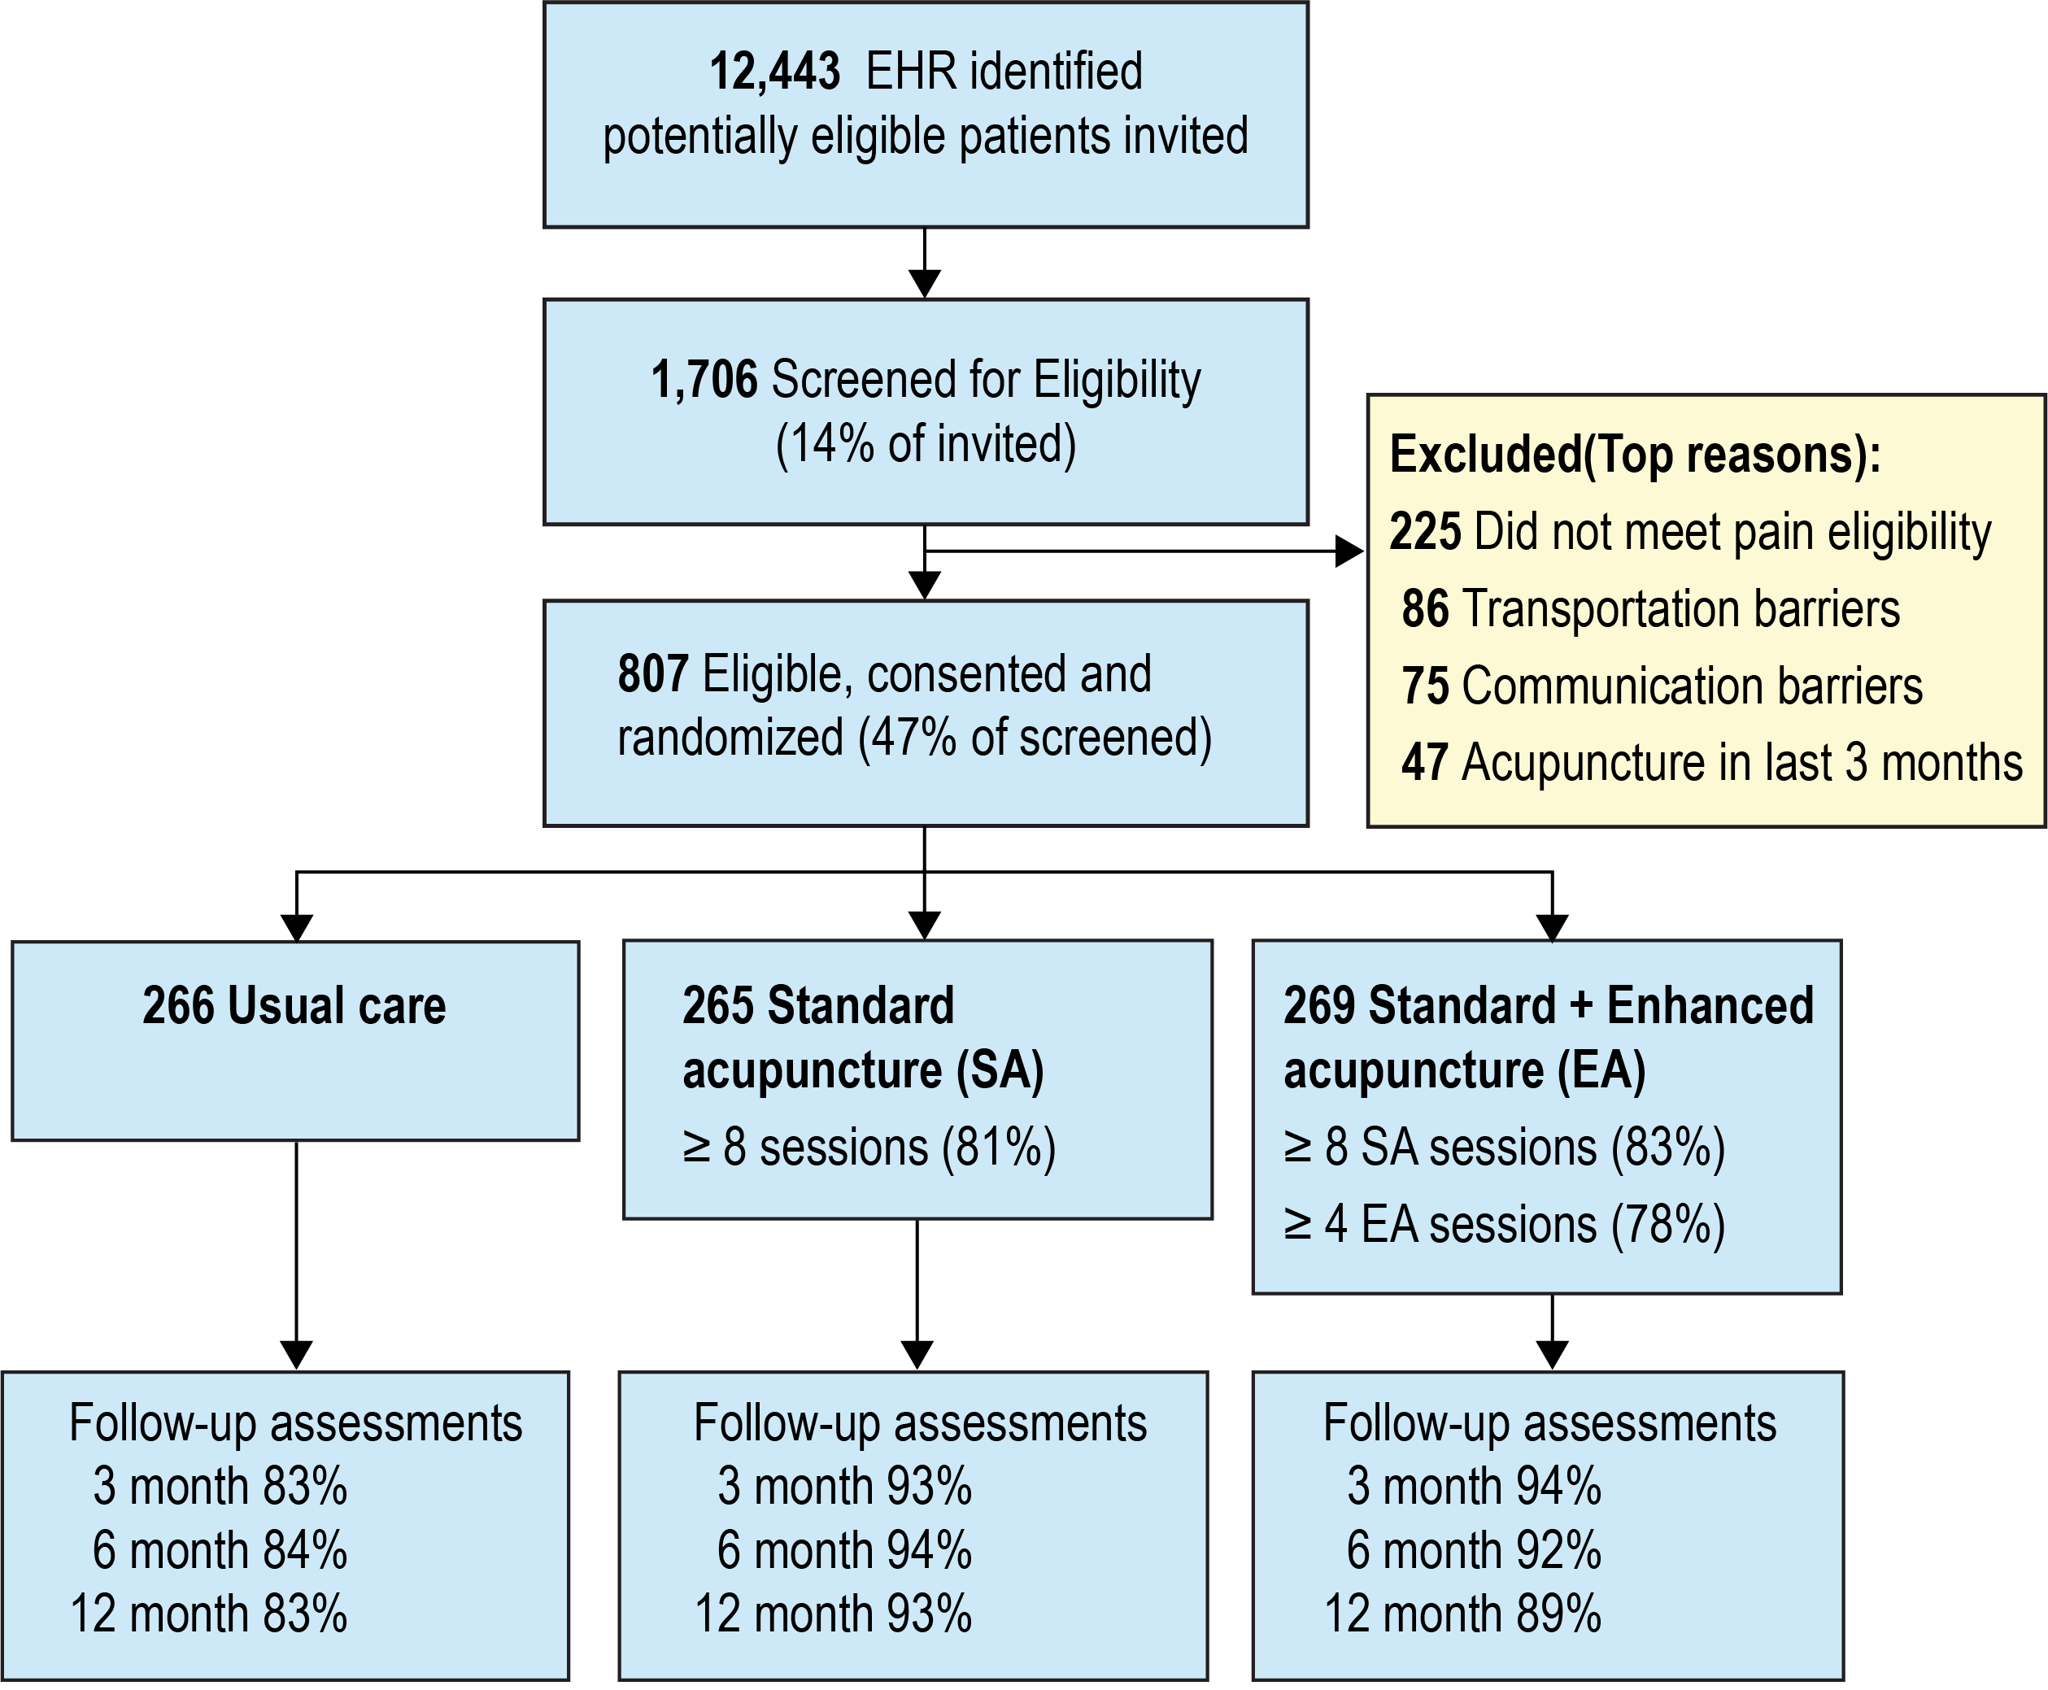
BackInAction
Participant Flow
Notes:
Balanced randomization BUT 10% lower f/u in usual care condition (and in NYC FQHC)

Slide 17
Baseline Participant Sociodemographic Characteristics*
Participant Characteristics | Total (N=800) | NYC – FQHC Network HCS (N=123) | Northern CA – Integrated HCS (N=286) | Pacific NW – Integrated HCS (N=185) | Northern CA – FFS HCS (N=206)
Age, mean (SD) | 73.6 (6.0) | 71.2 (5.7) | 73.2 (5.6) | 73.3 (5.8) | 76.1 (6.0)
Female, N (%) | 496 (62.0) | 89 (72.4) | 171 (59.8) | 108 (58.4) | 128 (62.1)
Education – At least some college | 678 (85%) | 69 (56%) | 252 (89%) | 162 (88%) | 195 (95%)
Household income
Less than $50,000 | 223 (28%) | 79 (64%) | 55 (19%) | 60 (32%) | 29 (14%)
$150,000 or more | 104 (16%) | - (<5%) | 33 (15%) | 23 (14%) | 46 (27%)
Race & Ethnicity, N (%)
White Non-Hispanic (NH) | 510 (64%) | 26 (21%) | 179 (63%) | 148 (80%) | 157 (76%)
Black or African American NH | 132 (17%) | 42 (34%) | 52 (18%) | 11 ( 6%) | 27 (13%)
Hispanic | 86 (11%) | 46 (37%) | 21 ( 7%) | 17 ( 9%) | - (<5%)
Asian | 42 ( 5%) | - (<5%) | 20 ( 7%) | - (<5%) | 15 ( 7%)
Other | 30 ( 4%) | 9 ( 7%) | - (<5%) | - (<5%) | - (<5%)
* FQHC – Federally Qualified Health Center, FFS – Fee for Service, HCS – Health Care System, NH - NonHispanic
Notes:
32/26% of NYC site didn’t report household income – of those reporting 63% reported <$25,000 with an additional 24% $25,000-$50,000 (from other sites NCal integrated HCS – 24% didn’t report, 18% NCal FFS, 9% WA Integrated HCS)

Slide 18
Baseline Participant Clinical Characteristics*
Participant Characteristics | Total (N=800) | NYC – FQHC Network HCS (N=123) | Northern CA – Integrated HCS (N=286) | Pacific NW – Integrated HCS (N=185) | Northern CA – FFS HCS (N=206)
Back Pain Characteristics
High Impact Chronic Pain | 375 (47%) | 74 (61%) | 124 (44%) | 73 (40%) | 104 (51%)
Number of Pain Conditions | 2.9 (1.4) | 2.8 (1.5) | 3.1 (1.3) | 3.3 (1.3) | 2.3 (1.4)
Roland Morris Disability Questionnaire (RMDQ) | 13.2 (5.5) | 17.3 (5.3) | 12.6 (5.4) | 12.2 (4.9) | 12.5 (5.2)
RMDQ ≥ 18 | 196 (25%) | 73 (59%) | 59 (21%) | 27 (15%) | 37 (18%)
PEG Score | 5.6 (2.2) | 7.3 (2.0) | 5.3 (2.1) | 5.0 (1.9) | 5.4 (2.2)
Long-term opioid therapy | -- | -- | 13 (4.5%) | 4 (2.2%) | 7 (4.3%)
Medical co-morbidity (Elixhauser) | 2.6 (2.0) | 2.9 (1.8) | 3.0 (2.0) | 2.6 (2.3) | 1.7 (1.6)
Comorbid mood/anxiety disorder | 215 (27%) | 47 (38%) | 77 (27%) | 57 (31%) | 34 (17%)
Frail | 156 (20%) | 48 (41%) | 44 (16%) | 29 (16%) | 35 (18%)
* FQHC – Federally Qualified Health Center, FFS – Fee for Service, HCS – Health Care System, NH - NonHispanic

Slide 19
Adverse Events
Serious Adverse Events
Comparable proportion of participants were hospitalized in acupuncture arms (9.0% SA [n=24], 8.1 % EA [n=22]), and usual care (6.3% UC [n=17]).
Only 1 (<1%) of those in acupuncture study arms identified as possibly related to study intervention – lower extremity cellulitis, treated successfully with IV antibiotics)
3 deaths (none considered related or possibly related to study intervention)
Adverse Events (participant reported – acupuncture arms only)
71 reported adverse events among 52 participants (9.7%) of the 534 in acupuncture study arms with most identified as related (n=29) or possibly related (n=21) to the study intervention
The most common treatment-related AEs including pain at needling site and cramping with a few reports of swelling, muscle spasm, headache, and dizziness.
Notes:
The incidence of cellulitis after acupuncture was 64.4 per 100,000 acupuncture sessions; 40/100,000 were lower extremity cellulitis (Lin 2019); for 229,230 patients in German study, (8.6%) reported experiencing at least one adverse effect.

Slide 20
Primary Analysis
Primary Outcome: Change in Functional Disability (RMDQ) from Baseline
Time Points: 3, 6 (primary), and 12 months
General Framework:
  GEE Analysis with all time points in the same model
  Robust Standard errors to account for correlation within person and acupuncturist
  Adjust for Baseline RMDQ, age, sex, race, and Health Care system
  Multiple Comparisons: Fisher’s Least Significant Difference Approach
  Missing Outcome Data: Combination of Pattern Mixture Imputation (missing outcome rates >15% at one site) and inverse weighting for those with no follow-up time points. Added additional covariates that were related to missingness to imputation and weighting models
    Education, BMI, Number of Pain Conditions, General pain, Substance Use Disorder, PEG, Pain Catastrophizing, and fear avoidance

Slide 21
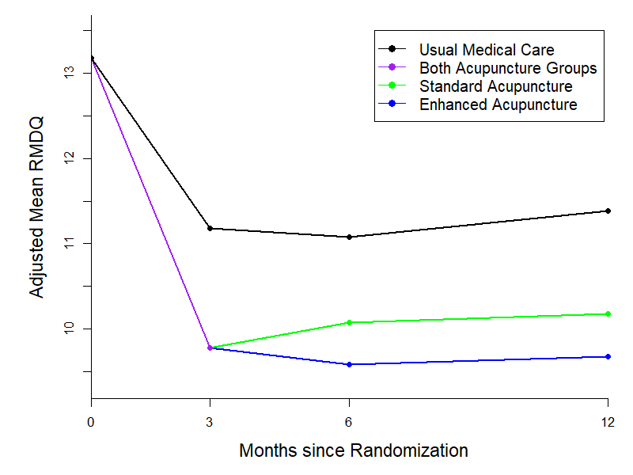
Pain-related Functional Disability*
* Using Roland Morris Disability Questionnaire (RMDQ) with higher scores = more disability

Slide 22

Functional Disability: Standard vs Enhanced Acupuncture
6 Months Difference (CI):
-0.5 (-1.5,0.5); P=0.29
12 Months Difference (CI):
-0.5 (-1.4,0.4); P=0.27
No Statistically Significant or Clinically Meaningful Differences between Standard and Enhanced Acupuncture
CI – confidence interval

Slide 23
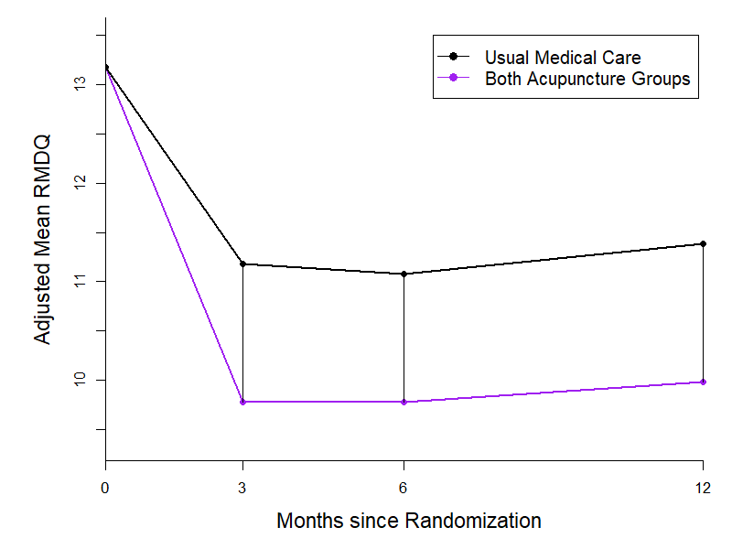
Functional Disability: Acupuncture vs Usual Care
12 Months Difference (CI):
-1.4 (-2.2,-0.6); SMD=-0.27
6 Months Difference (CI):
-1.3 (-2.0,-0.5); SMD=-0.27
3 Months Difference (CI):
-1.4 (-2.1,-0.7); SMD=-0.32
CI – Confidence Interval
SMD – Standardized Mean difference
(Effect size)
All P-values < 0.001

Slide 24
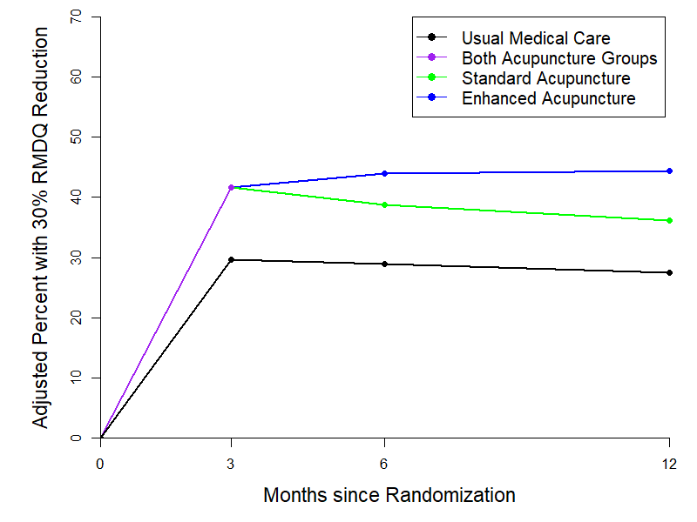
Minimal Clinically Important Differences in
Functional Disability
3 months RR (95% CI)
Acu vs UMC: 1.40 (1.16,1.68)
6 months RR (95% CI)
EA vs UMC: 1.52 (1.28, 1.81)
SA vs UMC: 1.34 (1.10, 1.63)
EA vs SA: 1.14 (0.94, 1.37)
12 months RR (95% CI)
EA vs UMC: 1.62 (1.39, 1.89)
SA vs UMC: 1.32 (1.09, 1.59)
EA vs SA: 1.23 (1.06, 1.42)
All statistically significant (P-Value<0.05) except for the comparison of EA vs SA at 6 months
RR- Relative Risk
CI – Confidence Interval

Slide 25
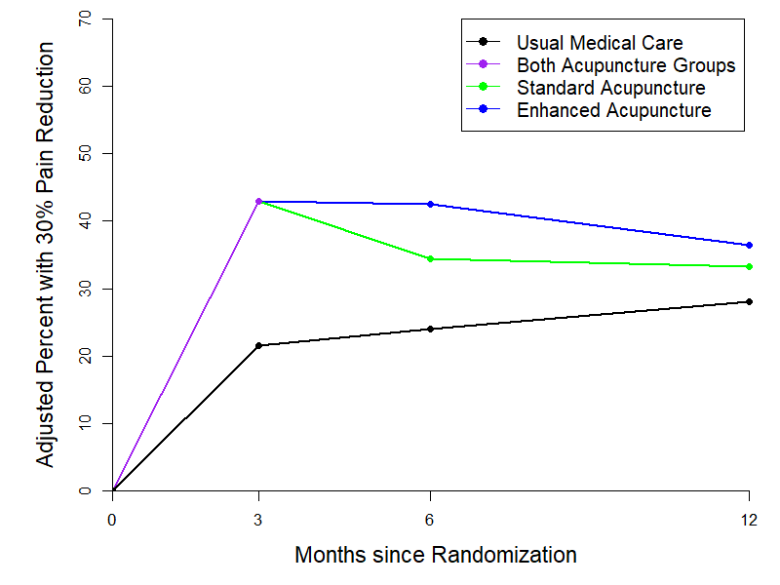
Minimal Clinically Important Differences in Pain Intensity
3 months RR (95% CI): P<0.001
Acu vs UMC: 1.98 (1.56, 2.52)
12 months RR (95% CI): P=0.044
EA vs UMC: 1.30 (1.06, 1.60)
SA vs UMC: 1.19 (0.96, 1.48)
EA vs SA: 1.10 (0.92, 1.30)
6 months RR (95% CI): P<0.001
EA vs UMC: 1.77 (1.40, 2.24)
SA vs UMC: 1.43 (1.10, 1.86)
EA vs SA: 1.24 (0.98, 1.56)
Large Statistically significant effects at 3 months that attenuate over 12 months
RR- Relative Risk
CI – Confidence Interval

Slide 26
Broader (Nonpain) Secondary Outcomes Findings
 | Adjusted Mean Differences in Changes from Baseline (95% CI) |  |  | P-
 | EA vs UMC | SA vs UMC | EA vs. SA | Value
Physical Functioning (PROMIS)
6 Months | 0.78 (-0.15, 1.71) | 0.15 (-0.77, 1.07) | 0.63 (-0.38, 1.64) | 0.241
12 Months | 0.50 (-0.40, 1.39) | 0.67 (-0.27, 1.61) | -0.18 (-1.02, 0.67) | 0.354
Social Functioning (PROMIS)
6 Months | 1.13 (-0.25, 2.51) | 0.82 (-0.39, 2.03) | 0.31 (-1.05, 1.68) | 0.219
12 Months | 1.55 (0.43, 2.68) | 1.78 (0.69, 2.88) | -0.23 (-1.23, 0.77) | 0.004
Depression (PHQ-2)
6 Months | -0.28 (-0.51, -0.05) | -0.25 (-0.49, -0.01) | -0.03 (-0.23, 0.18) | 0.047
12 Months | -0.05 (-0.25, 0.15) | -0.16 (-0.38, 0.06) | 0.11 (-0.06, 0.28) | 0.304
Anxiety (GAD-2)
6 Months | -0.26 (-0.52, -0.01) | -0.33 (-0.58, -0.07) | 0.06 (-0.18, 0.30) | 0.034
12 Months | -0.30 (-0.54, -0.05) | -0.39 (-0.63, -0.15) | 0.11 (-0.06, 0.28) | 0.006
Fatigue (PROMIS)
6 Months | -0.98 (-2.53, 0.58) | -0.51 (-2.04, 1.01) | -0.47 (-2.30, 1.37) | 0.445
12 Months | -2.32 (-3.62, -1.03) | -1.29 (-2.68, 0.11) | -1.03 (-2.22, 0.15) | 0.002
Sleep Quality (PROMIS)
6 Months | -1.02 (-2.37, 0.34) | -0.44 (-1.67, 0.78) | -0.58 (-1.88, 0.73) | 0.340
Bold indicates statistical significance at 0.05 level

Slide 27
Main Study Findings & Why They Matter
Positive and sustained (modest) effect of acupuncture on pain-related disability
Comparable effects to those seen in other acupuncture and nonpharmacologic LBP trials (effect size – 0.27 [12 mo] -0.32 [post-tx])
Compelling benefit/harms of acupuncture: focused on older adults –
    Higher comorbidities and polypharmacy than younger adults
    Age-related physiological changes = more risks associated with common pain treatments
Delivered by those currently best able to provide real world care
  50+ acupuncturists (LAc’s) practicing in the community (accessibility)
Effect sustained well past active 3-month standard acupuncture intervention
    Longer effect duration: compared to opioid & nonopioid medication effects
    Maintenance sessions appear to boost shorter term reduction in pain and % with longer term improved functioning
    BUT less clear benefit for broader whole health outcomes (e.g., sleep, depression, fatigue) with exception of anxiety
Favorable safety profile – no acupuncture related serious adverse events

Slide 28

Acupuncture for Low Back Pain in Older Adults
Cost-Effectiveness
Patricia M. Herman, ND, PhD
Senior Behavioral Scientist

Slide 29
Overview
Low back pain is prevalent in older patients and expensive in terms of healthcare costs.
Acupuncture has been found effective for back pain. However, little is known about its economic impacts, especially in this Medicare population.
This is an economic evaluation alongside a pragmatic, multi-site clinical trial.

Slide 30
Methods
Study Arms:
  Usual medical care (UMC) alone
  UMC + Standard Acupuncture (SA) – up to 15 treatments over 12 weeks
  UMC + SA + Enhanced Acupuncture (EA) – up to 6 additional sessions over next 12 weeks
  Needling limited to a list of 113 named acupoints using manual stimulation only
Subjects: >65 years of age with chronic (>3 mos) low back pain and >3 out of 10 on pain interference
Effectiveness:
  Quality-adjusted life-years (QALYs) based on EQ-5D-5L
  Proportion with a minimal clinically important difference (MCID) change on the RMDQ
Costs:
  Healthcare utilization from the health systems’ Virtual Data Warehouse
  Valued using an algorithm that estimates Medicare national rates
  Patient copays and coinsurance removed from health care sector costs to give Medicare costs
Protocol: DeBar et al. Contemp Clin Trials 2023; 128:107166.

Slide 31
Analysis
Cost-Effectiveness Formula:
Cost_{SA or EA} – Cost_{UMC}
ICER = ----------------------------------------
QALY_{SA or EA} – QALY_{UMC}
[Also, calculated ICER using %MCID_{SA or EA} - %MCID_{UMC}]
Health care sector perspective costs =
All healthcare costs
Medicare perspective costs =
Medicare reimbursed healthcare costs

Slide 32
Participant Flow
800 Eligible, Enrolled and Randomized
266 Randomized to receive usual medical care (UMC) alone
265 Randomized to Standard Acupuncture (SA)
269 Randomized to Standard + Enhanced Acupuncture (EA)
225 Included in economic evaluation*
222 Included in economic evaluation*
225 Included in economic evaluation*
*Healthcare utilization data were not available at Institute for Family Health sites. N=5 subjects were also dropped because they had no healthcare utilization in either the pre- or post- enrollment years.

Slide 33
Baseline Characteristics
 | UMC (n=225) | SA (n=222) | EA (n=225)
Age, M (SD), y | 74.2 (5.9) | 73.8 (5.8) | 74.3 (6.1)
Women | 137 (61%) | 133 (60%) | 136 (60%)
Doctoral or post-grad | 80 (36%) | 68 (31%) | 83 (37%)
White, Non-Hispanic | 167 (74%) | 144 (65%) | 170 (76%)
Hispanic | 11 (5%) | 16 (7%) | 12 (5%)
Income <$50k | 52 (23%) | 52 (23%) | 40 (18%)
Income $50k-$100k | 58 (26%) | 69 (31%) | 74 (33%)
Income >$100k | 70 (31%) | 66 (30%) | 66 (29%)
Married or living as | 142 (63%) | 138 (62%) | 140 (62%)
High Impact Chronic Pain | 89 (40%) | 103 (46%) | 105 (47%)
HRQoL (EQ-5D-5L), M (SD) | 0.62 (0.27) | 0.58 (0.27) | 0.60 (0.27)
None of the variables were statistically significantly different across groups at p<.05.

Slide 34
Effectiveness Over the One-Year Study
 | UMC (n=225) | SA (n=222) | EA (n=225)
Gain in QALYs over Year | 0.025 (0.004, 0.046) | 0.048 (0.026, 0.071) | 0.060 (0.041, 0.080)
Gain in QALYs over UMC | --- | 0.014 (-0.014, 0.043) | 0.037 (0.013, 0.062)
Proportion who achieved MCID improvement in RMDQ | 0.342 (0.275, 0.410) | 0.411 (0.344, 0.477) | 0.526 (0.461, 0.592)
Proportion achieving MCID compared to UMC | --- | 0.069 (-0.027, 0.164) | 0.185 (0.090, 0.279)

Slide 35
Results (Back-related costs net of baseline; 2022 USD)
 | UMC (n=225) | SA (n=222) | EA (n=225) | SA - UMC | EA - UMC | EA - SA
Cost of the intervention | $0 | $988 | $1,422 | $988 | $1,422 | $434
Hospital inpatient stays | $249 | $474 | -$1,127 | $225 | -$1,375 | -$1,600
Hospital ambulatory visits | $27 | -$116 | -$85 | -$144 | -$113 | $31
Hospital amb surgery visits | -$33 | -$231 | -$173 | -$198 | -$140 | $58
Outpatient clinic visits | -$111 | -$159 | -$179 | -$48 | -$68 | -$20
Email, telephone & video visits | -$38 | -$57 | -$67 | -$19 | -$28 | -$9
Pharmacy fills/refills | $38 | -$31 | -$165 | -$69 | -$203 | -$134
Other costs | -$10 | $17 | $4 | $27 | $14 | -$12
Total Health Care Sector Costs | $122 | $883 | -$369 | $762 (-$0.8k, $2.4k) | -$491 (-$2.9, $1.1k) | -$1,252 (-$3.4k, $0.4k)
Patient Copays & Coinsurance | -$31 | -$113 | -$101 | -$81 | -$70 | $11
Total Medicare Costs | $153 | $996 | -$268 | $843 (-$0.7k, $2.5k) | -$421 (-$2.7k, $1.2k) | -$1,264 (-$3.4k, $0.4k)
*Costs 95% bias-corrected and accelerated bootstrap CIs. All CIs adjusted for imputed missing data.

Slide 36
Health Care Sector Cost / QALY Cost-Effectiveness Plane
SA – UMC: 16% cost saving
EA – UMC: 64% cost saving

Slide 37
Summary of Results
Results are all per participant over one year
SA compared to UMC – cost-effectiveness depends:
  Increased total health care sector costs by $762
    ICER: $54,429/QALY
  Increased total Medicare costs by $843
    ICER: $60,214/QALY
  QALY gain of 0.014
  Proportion achieving RMDQ MCID increased by 0.069
EA compared to UMC – cost saving (dominant):
  Reduced total health care sector costs by $491
  Reduced total Medicare costs by $421
  QALY gain of 0.037
  Proportion achieving RMDQ MCID increased by 0.185

Slide 38





FQHC that has lean administration in clinical operations and research: focus on efficiency and leveraging existing processes
Analogous approach to clinical process
Dr. Raymond Teets
Institute for Family Health
New York City and Hudson Valley

Slide 39

Common barriers to access acupuncture
Financial obstacles such as lack of insurance coverage
Logistical barriers including limited neighborhood accessibility
Limited awareness on the benefits of acupuncture therapy
General mistrust
Le, Almaw, Rinaldi et al, Front Public Health, 2023
Saper, Glob Adv Health Med, 2016
Li, Darby, Akpotu, J Integr Complement Med, 2024
Notes:
Consider including these two citations in abbreviated form (e.g., Le, Almaw, Rinaldi et al, Glob Adv Health Med, 2016) at slide bottom (from the IFH manuscript under review0
Le D, Almaw RD, Rinaldi D, et al. Barriers and strategies for recruiting participants who identify as racial minorities in musculoskeletal health research: A scoping review. Front Public Health. 2023;11:1211520.PMC10433765
Saper R. Integrative medicine and health disparities. Glob Adv Health Med. 2016;5(1):5-8.PMC4756775
Li H, Darby JE, Akpotu I, et al. Barriers and facilitators to integrating acupuncture into the U.S. Health care system: A scoping review. J Integr Complement Med. 2024

Slide 40
Outreach / recruitment
Spanish speaking recruitment
Recruitment through provider referral
  Marketing efforts to raise awareness through brief live announcements / emails / EPIC® messages
Use of Best Practice Alert in Electronic Health Record Epic® to aid in referrals for acupuncture
All messaging from medical providers to research team via EHR
Teets, Nielsen, Mah et al, Under review
Notes:
Again, consider including citation at slide bottom:
Teets RY, Nielsen A, Mah DM, et al. Recruitment and retention for an acupuncture trial in a minoritized 65 and older population with chronic low back pain. 2025; under review.

Slide 41
Pop-up clinic
Research acupuncture clinics embedded in IFH Clinical Operations
  EHR scheduling
  Acupuncture session documentation in EHR
    Specialized session form template created
    Good data collection
    Visible to other staff and so normalization
  Pop-up clinic in low-cost areas of clinic
    Clinical Research Coordinators (CRCs) expanded role as “care navigators”
    Creation of lead acupuncture researcher as Research Clinical Director (RCD)

Slide 42
QI for clinic
Survey collection on implementation efforts in Acupuncture Clinic
  Important collaboration between RA’s, CRC and RCD
  Way to also watch for no shows and risk for missed retention

Slide 43


Reached recruitment of n (123)
Success!

Slide 44
Demographics
Characteristic | Number (% of total at IFH)
Age, mean (SD)^{b} | 71.2 (5.7%)
Age ≥75 years old | 28 (22.8%)
Female, N (%)^{b} | 89 (72.4%)
Education (at least some college) ^{b} | 73 (59.4%)
Household incomed ^{b}
Less than $25,000 | 57 (62.6%)
$25,000-$49,999 | 22 (24.2%)
$50,000 or more | 12 (13.2%)

Slide 45
Demographics
Characteristic | Number (% of total at IFH)
Insurance
Private | 7 (5.7%)
Public | 108 (87.8%)
None | 8 (6.5%)
Race and ethnicity ^{b}
White non-Hispanic | 26 (22.0%)
Black or African American Non-Hispanic | 42 (35.6%)
Hispanic | 46 (39.0%)
Other | 4 (3.4%)

Slide 46
Demographics & Clinical Characteristics
Characteristic | Number (% of total at IFH)
Spanish language preference ^{b} | 33 (26.8%)
Married or Domestic partnered ^{b} | 31 (25.4%)
Clinical Characteristics
BMI obese (≥30 kg/m2), N (%) | 63 (51.2%)
Frail,^{b,c} N (%) | 48 (40.7%)
High Impact Chronic Pain, N (%) | 74 (61.2%)
Number of pain conditions,^{c} mean (SD) | 2.8 (1.5)
Mental Health Mood Disorder diagnosis N (%) | 47 (38.2%)
Depression diagnosis, N (%) | 32 (26.0%)
Anxiety diagnosis, N (%) | 24 (19.5%)

Slide 47
Retention rates
IFH lower than other BIA sites
  Study withdrawal rate was 12.2% with 18.7% missingness in follow-up data rates at 6 months, the trial’s primary outcome timepoint
  Comparable to similar Integrative studies with under-represented populations
    AADDOPT-2 (Acupuncture trial) & GAPYOGA (Acup with Yoga trial)*
    *McKee, Nielsen, Anderson et al, JGIM, 2020; Teets, Nielsen, Moonaz et al, Glob Adv Integr Med Health, 2023; Teets et al. 2025 under review
Notes:
Short form citations already included above:
McKee MD, Nielsen A, Anderson B, et al. Individual vs. Group delivery of acupuncture therapy for chronic musculoskeletal pain in urban primary care—a randomized trial. J Gen Intern Med.2020;35(4):1227-1237
Teets R, Nielsen A, Moonaz S, et al. Group acupuncture therapy with yoga therapy for chronic neck, low back, and osteoarthritis pain in safety net settings for an underserved population: A feasibility pilot study. Glob Adv Integr Med Health. 2023;12:27536130231202515.PMC10540610

Slide 48
Adaptations Summary
Barrier | Adaptation | Comment
Financial obstacles such as lack of insurance coverage | No cost to patient through research funding | Reasonable rate of payment to research LAcs
Logistical barriers including limited neighborhood accessibility | Embedded acupuncture clinic in 3 regional home clinics | Acupuncture clinics spread across NYC region
Limited awareness on the benefits of acupuncture therapy | Marketing to providers, staff and patients | Known acupuncture at one site, providers vouch for research via referral (and acupuncture treatment)
General mistrust | Routing recruitment through provider referrals | Done within EHR for provider ease

Slide 49
Recent CMS Medicare Reimbursement Coverage for Acupuncture Needling among Older Adults with Chronic Low Back Pain: Misalignment with Current Community Acupuncture Services? (outcome and access implications)
Lynn L DeBar – Kaiser Permanente Center for Health Research
Arya Nielsen – Icahn School of Medicine at Mount Sinai, Dept of Family Medicine and Community Health Morgan Justice – Kaiser Permanente Washington Health Research Institute
Jessica Coifman – Kaiser Permanente Washington Health Research Institute

Slide 50
CMS Policy: Medicare Reimbursement for Acupuncture
≥ 12 acupuncture (needling only) visits in 90 days covered for patients with nonspecific chronic low back pain under following circumstances:
  Low back pain chronic (≥ 12 weeks duration)
  Pain is nonspecific (no identified systemic cause)
  Pain is not associated with surgery
Potential for up to 8 additional sessions for patients demonstrating improvement in pain/functioning. 20 session annual limit for reimbursement.

Slide 51
CMS Policy: Medicare Reimbursement for Acupuncture
Medicare Qualified (Reimbursable) Acupuncture Providers
  MDs/DOs: in accordance with applicable state requirements
  PAs, NPs, CNSs, and auxillary personnel (LAc’s/DAOMc’s) with masters or doctoral degree in acupuncture or Oriental Medicine from accredited school and state license to practice acupuncture
  Auxillary personnel (LAc’s/DAOMc’s) providing acupuncture must be under the appropriate level of supervision of a physician, PA, or NP/CNS
  Any FQHC reimbursement by Medicare for acupuncture requires a primary care provider visit on the same day (a barrier to access)

Slide 52
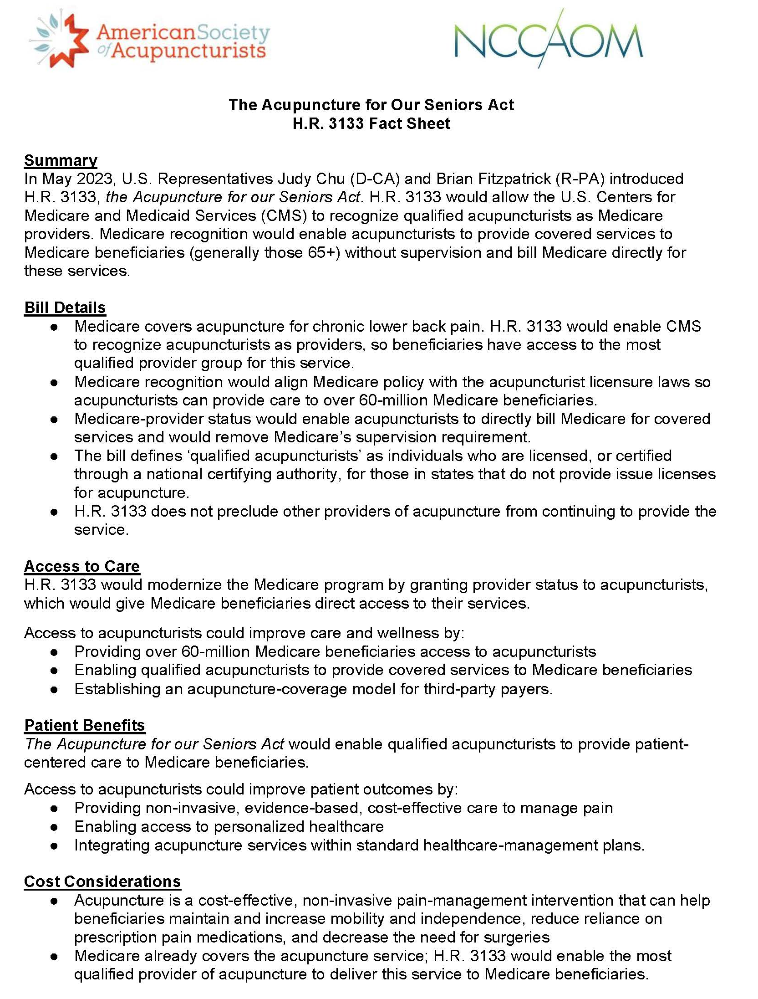
Congressional Advocacy Efforts Supported by Acupuncture Professional Societies

Slide 53
Impact of CMS Policy: Survey/Interviews with Key Informants
Overall Goal
  Consider perspectives/experiences on the impact and actionability of providing acupuncture-related services congruent with CMS Medicare Reimbursement guidelines on patients, providers, and those in clinical/policy leadership roles including:
    Alignment of CMS policy allowances with the ‘acupuncture’ treatment needs of older adults with cLBP and ‘best practice’ approach
    Feasibility of implementing policy in current form; refinement recommendations; and benefits/liabilities of ‘acupuncture needling’ services provided by wider array of clinicians (LAc’s, MDs, etc.)
Who
  Study Acupuncturists (Licensed acupuncturists [LAc’s] practicing in community and embedded in primary care clinic in clinical study regions– 30 survey respondents (14 participated in follow-up in-depth interviews
  Other Key Informants (MDs/MD acupuncturists, Clinicians (mainly acupuncturists) overseeing large healthcare system acupuncture programs, those involved with acupuncture-related policy or training/licensure programs, mixtures of above) – 16 interviewees.

Slide 54
Acupuncturist Survey Findings
Acupuncture Study Element / CMS Policy Perspective | Findings
Fit of session number, frequency, and structure (standard + maintenance sessions) | 100% - somewhat or very similar to routine practice
How effective was study acupuncture intervention for reducing pain and improving function | 100% - somewhat or very effective
- compared to acupuncture care that included other modalities? | 23% - not at all effective 73% - somewhat effective (only 3% very effective)
- most frequent Traditional Chinese Medicine (TCM) modalities would include if allowed | 88% - heat lamp or hot compress nearly every session 53% - Tuina (TCM massage) nearly every session
Proportion of patients presenting with significant co-existing health issues | 66% - at least half of those treated (other pain conditions > mood or other mental health dx > sleep issues > energy/fatigue and mobility/balance)
- when present, acupuncture helpful to address? (and in turn might reduce pain / improve function) | 63% - at least half of those w/co-existing conditions (other pain > mood or other mental health dx > sleep issues > energy fatigue)
Able to bill and receive reimbursement from Medicare | 3% - yes
Perspective on MD abbreviated acupuncture needling training | 80% - believed may significantly compromise quality of acupuncture treatment
Notes:
[aligning practice with MD] Well it would mean that I would have to be in a medical office under the sort of scrutiny or its just a whole different ball game. OK? Because then you are suddenly in that medical system where they can dictate what you can do, what you cannot do, how you have to do it,.. and many times the expenses become much higher because they want to be reimbursed for that office visit and that costs a heck of a lot of money because they usually do and their billing staff and what not and I’m not sure that it would be sustainable in the long run and it would take away the freedom of us doing. (Acu 33)

Slide 55
Key Interview Findings – “They’ve Created a Pseudo Benefit”
Theme | Quote
Required supervisory structure* significant barrier to access and not clinically indicated (All respondents) | It’s untenable for acupuncturists currently… 1-3% of acupuncture providers in the US are in a medical physician’s office, which is the current supervision requirement…that is disheartening and troubling…we’re looking at 66 million people who are not able to access a treatment by the subject matter experts in the field best trained to provide it. Two, there is no state that requires medical supervision to provide direct [acupuncture] care. (Acupuncturist / Policy expert)
 | MD’s have no clue what an acupuncturist does. Acupuncturists are themselves advanced providers of care and so it makes no more sense for them to be overseeing us as it would … for them to be overseeing nurse practitioners and not let them practice at the top of their licensure or… scope. That’s a problem because it’s going to both frustrate the advanced provider of care and it puts scutwork on the MD’s plate. Any time you have to pay an MD to do more work, we’re essentially costing someone money, whether it’s the MD or the system. (Acupuncturist lead of HCS program)
Key Caveat: CMS required supervisory structure likely due to need for CMS billing oversight/responsibility and not practice oversight
Notes:
Clarify this is likely a CMS billing oversight/responsibility and not practice oversight.

Slide 56
Key Interview Findings – “They’ve Created a Pseudo Benefit”
Theme | Quote
Limitations (& benefits) of MD acupuncturists | You don’t come out of the 300 hour training really highly skilled to offer a comprehensive acupuncture diagnosis… You just don’t. Most of the people including me, who graduate from MD acupuncture training, don’t end up dedicating enough time to their acupuncture part of their practice to become really, really highly skilled at diagnosis and treatment…In my view, being an effective clinician is a lot more about clinical experience than it is to what you learn in school…I think licensed acupuncturists come out of school much better equipped to treat a much wider range of problems in a more comprehensive and effective way (MD Acupuncturist)
 | I just think jeez Louise, there’s enough to do in traditional allopathic medicine without saying yes, I’m a doctor so I can do this ...I just think it’s another way we’ve medicalized things, and think we can do them. And in fact there’s people who can do it better I think as a general rule. (MD / Policy Expert)
 | For people unfamiliar with acupuncture, to have your doctor or a doctor that you already have confidence in give you that first experience of acupuncture can be a real opening of a door. (MD Acupuncturist)

Slide 57
Key Interview Findings – “They’ve Created a Pseudo Benefit”
Theme | Quote
Patient benefit confusion and impact on therapeutic alliance (Medicare & Medicare Advantage Plans) | I wish they would cover acupuncture or not cover acupuncture or not cover acupuncture. There is so much fine print with Medicare ‘covering’ acupuncture even when it is for chronic low back pain. It is just confusing for both the provider and patient when acupuncture is supposed to be covered yet it is hard to get reimbursed. There needs to be more clarity for the patient and provider alike. (Study Acupuncturist)
 | I have to tell this patient that I’m not able to treat them because I’m not a Medicare provider and there’s frankly a lot of contention with patients because they’re sure they have this benefit, they don’t understand why I can’t provide that for them. (Study Acupuncturist)
YET broad appreciation for CMS taking steps to cover acupuncture treatment | It provides legitimacy for acupuncture in general that it is a covered benefit in Medicare (Clinician overseeing large healthcare system acupuncture program)
 | I’m hugely grateful for CMS for giving us what they did. I think there’s some things that we can tinker on, and I understand that they gave us almost everything they possibly could within the scope of what they have control over. (Acupuncturist overseeing large healthcare system acupuncture program)

Slide 58
Key Interview Findings
“It’s Like Practicing with One Hand Behind Your Back”
Theme | Quote
Restriction to needling attenuates impact and inconsistent with real world practice | Using localized heat and manual therapies is a way that I prepped my patients for the needle insertion and Medicare doesn’t allow me to do those things, or at least not to bill for them. (Study Acupuncturist)
 | A lot of the challenge from my point of view is that CMS wants to be able to point to studies of effectiveness of different aspects of acupuncture technology … most studies until recently didn’t allow the acupuncturists to incorporate anything but needles. So, CMS is a little bit hamstrung in terms of their guidelines for how they‘re supposed to make decision. …we weren’t intelligent enough about having a pragmatic approach to what it means to get acupuncture treatment… Acupuncture researchers were either trying to or were forced to fit into the box of protocolized needle treatments. That’s just really a bummer. (MD Acupuncturist / Policy Expert)
Restriction to chronic low back pain focus misaligned with TCM treatment and likely reduced effectiveness for older adults | Medicare patients don’t just have chronic low back pain, they have knee pain, hip pain, a lot of sleep disorders. All of these things could also be helped with acupuncture and, unfortunately, CMS only approved a benefit for chronic low back pain. So I see that as an obstacle, hindrance for patient access. (Acupuncturist lead of large HCS program)

Slide 59
The Acupuncturist Quote that Sums It All Up…
“Licensed Acupuncturists should be given the opportunity to become Medicare providers, just like MDs. Our depth and breadth of training prepares us to give more effective and much safer treatments. We should be able to treat and bill for related conditions like ankle, knee and hip pain. We should be allowed to use and bill for heat and manual therapies to better prepare the patient for needle insertion. These additional modalities are essential for safe and effective acupuncture, and their absence has a negative impact on clinical outcomes.”
Notes:
Increased font size

Slide 60
It Takes A Village…
KP Washington
Julia Anderson
Jessica Coifman
Andrea Cook
Lynn DeBar
Bianca DiJulio
Carolyn Eng
Jane Grafton
Gabrielle Gunderson
Laurel Hansell
Luesa Healy
Clarissa Hsu
KP Washington
Morgan Justice
Doug Kane
Sherry Kubitz
Aidan Nguyen
Annie Piccorelli
Karen Sherman
Chi Tran
Juanita Trejo
Rob Wellman
Nora Wheat
Yishi Xian
KP Northern California
Crystal Aparicio
Andy Avins
Mahesh Bulbule
Gabriela Sanchez
Sutter Health
Crystal Baggott
Lisa Dean
Alyssa Hernandez
Heather Law
Vicki Li
Ridhima Nerlekar
Alice Pressman (currently KPSOM)
Alex Scott
Katie Stone
Sylvia Sudat
Institute for Family Health
Matt Beyrouty
Ariel Jacobs
Estefhany Luz Soto Cossio
Donna Mah
Arya Nielsen
Phoebe Rosenheim
Ray Teets
Other Study Collaborators
Basil Eldadah– NIA (Project Scientist)
Patricia Herman – RAND
Sam Mann - RAND
Lanay Mudd / Robin Boineau– NCCIH (Project Officers
[present/past])
Qilu Yu – NCCIH biostatistical advisor
The many (50+) licensed acupuncturists who treated study participants and the 800 older adult participants!!

Slide 61
Panel Learning Objectives and Key Questions
  Learning Objectives
    To understand elements to conduct pragmatic clinical trials on effectiveness / cost-effectiveness of acupuncture in everyday clinical care settings.
    To appreciate the contextual factors in potentially adopting and sustaining acupuncture care within a variety of healthcare settings.
    To consider adaptations to mitigate barriers to acupuncture access for diverse populations cared for in under-resourced community health centers.
  Key Questions
    What are the implications of the study being limited to use of needling rather than broader inclusion of other modalities/approaches often used by acupuncturists?
    What is the potential for findings to improve access of acupuncture services for older adults with back pain given that CMS Medicare reimbursement restrictions currently don’t allow for licensed acupuncturists to be recognized as independent practitioners able to directly bill for services?
    How do we understand potential differences in significance of maintenance sessions in patient reported outcomes and cost-benefit analyses?

